Slide 1
Processing Event Based Cameras with Gabor Filters
Veli Can Erdem

Slide 2
Research Question
Can the research of Brosch et.al (2015) be improved by changing certain aspects as in:
Amount of filters.

Slide 3
Main Idea
By using Gabor filter, which is composed of different filters in its Fourier transform, it is possible to create a complex filter that can be used in conjunction with temporal filters, that can resemble neurons in mammal eyes.

Slide 4
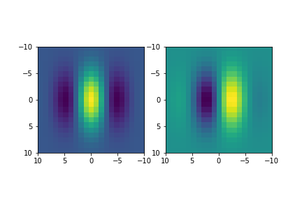
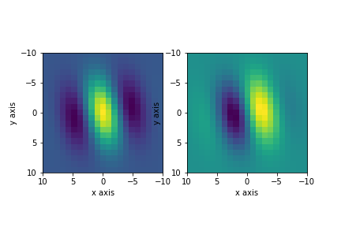
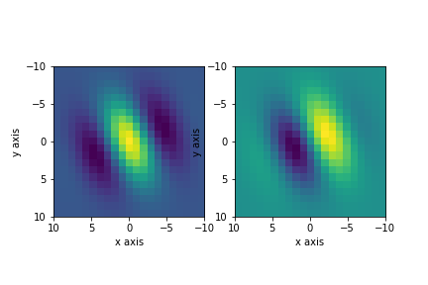
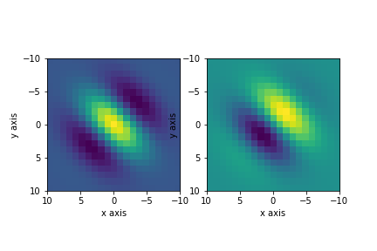
Spatial Filter (32 * 2 filters are used)

Slide 5
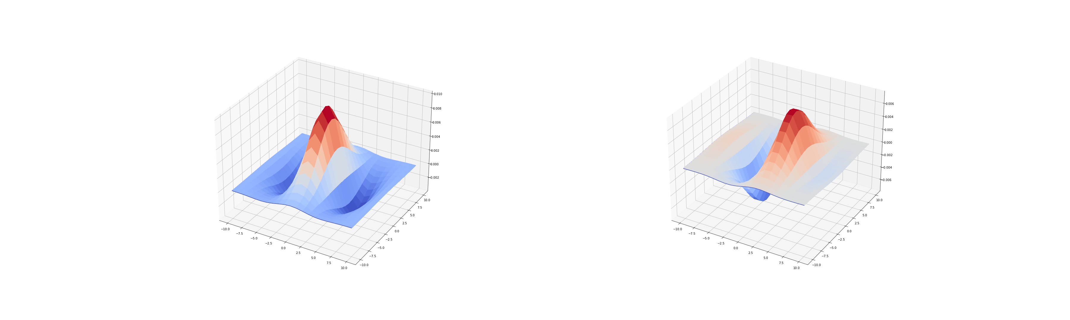
Spatial Values

Slide 6
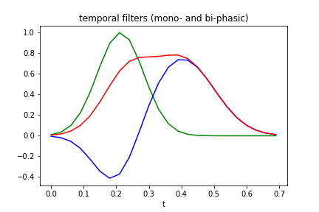
Time Filters

Slide 7
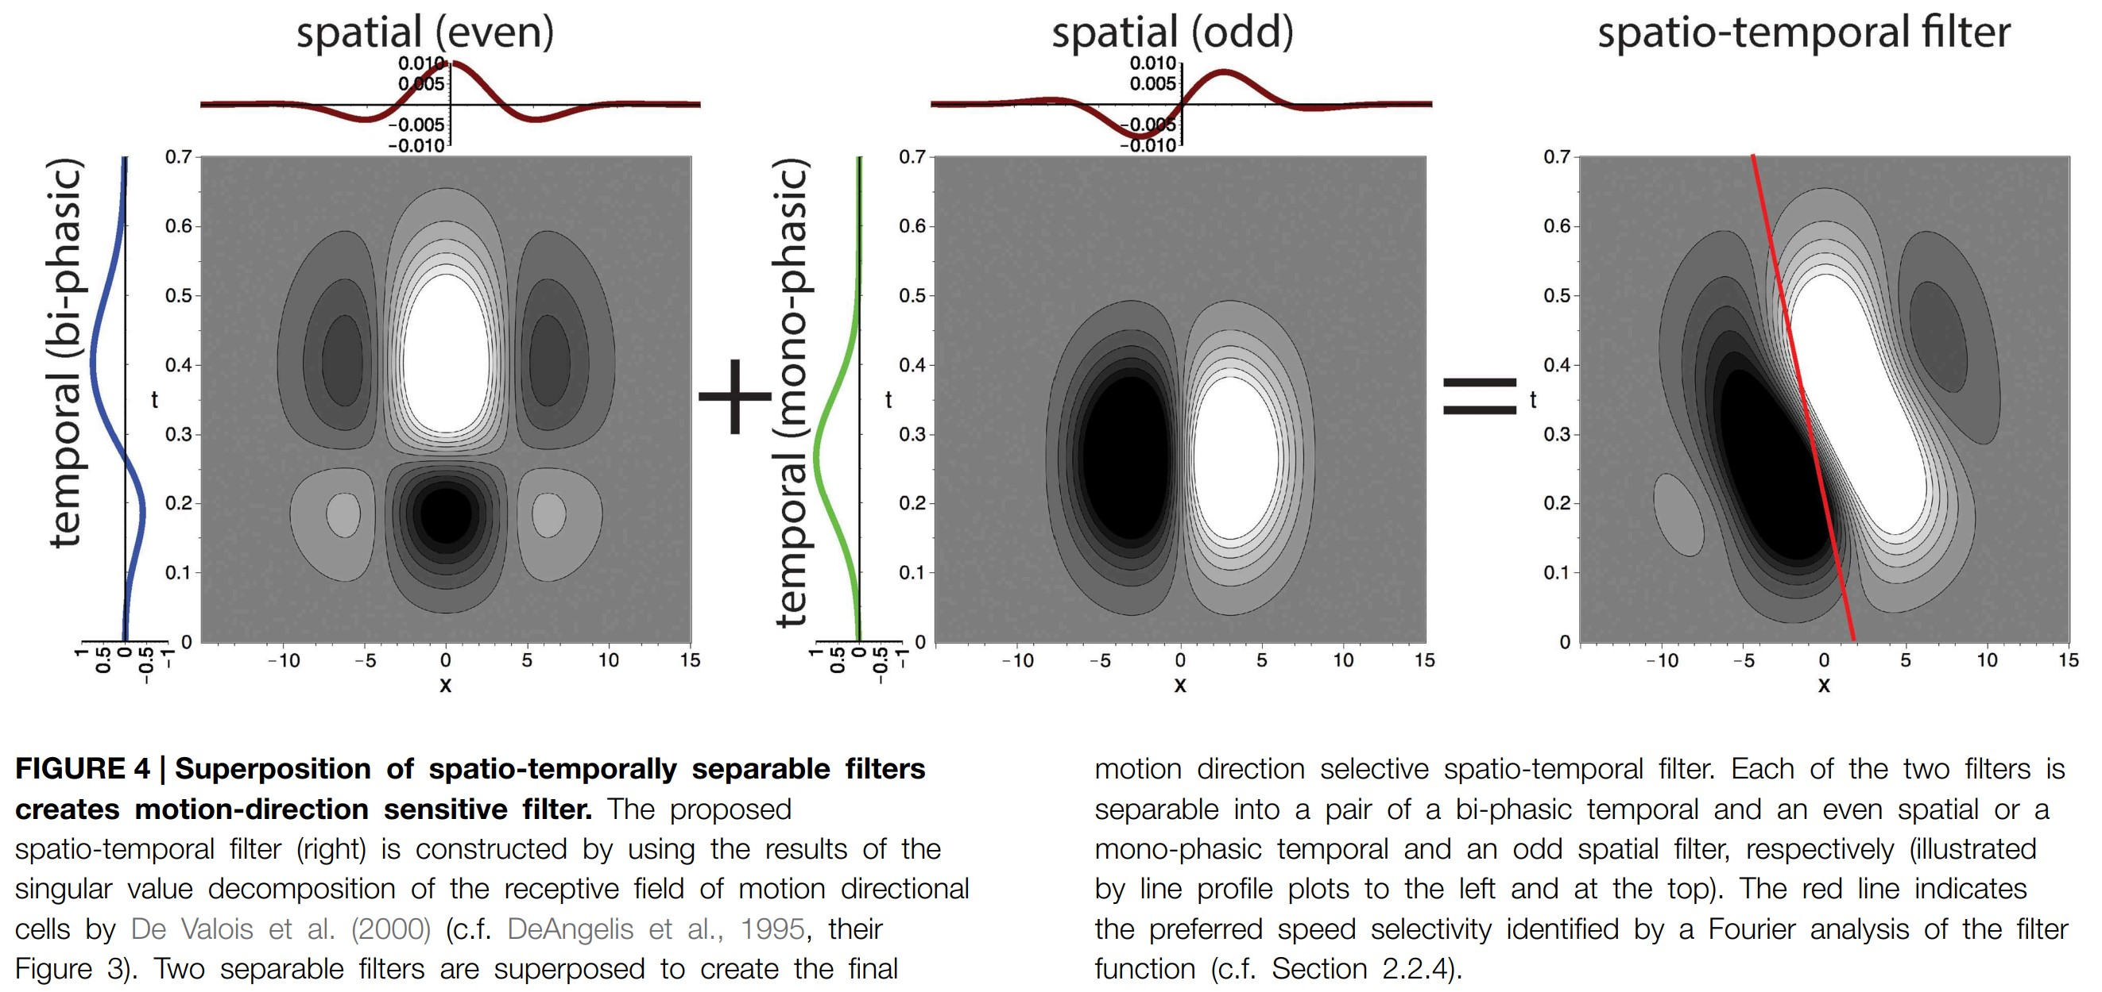
Combined

Slide 8
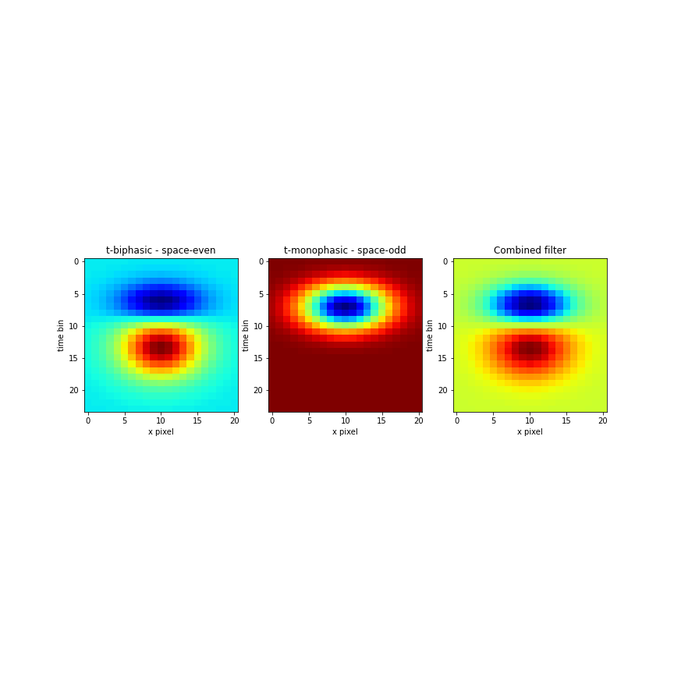
Filter Examples

Slide 9
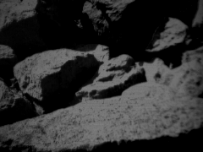
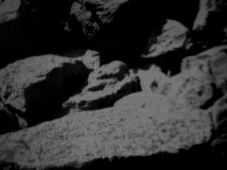
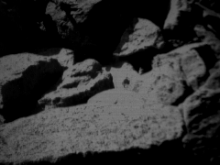
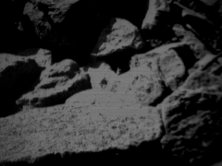
Used Dataset

Slide 10
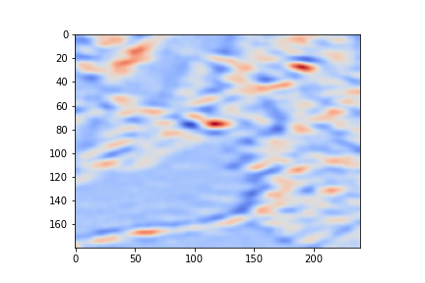
Result over 0.7 seconds timeframe

Slide 11
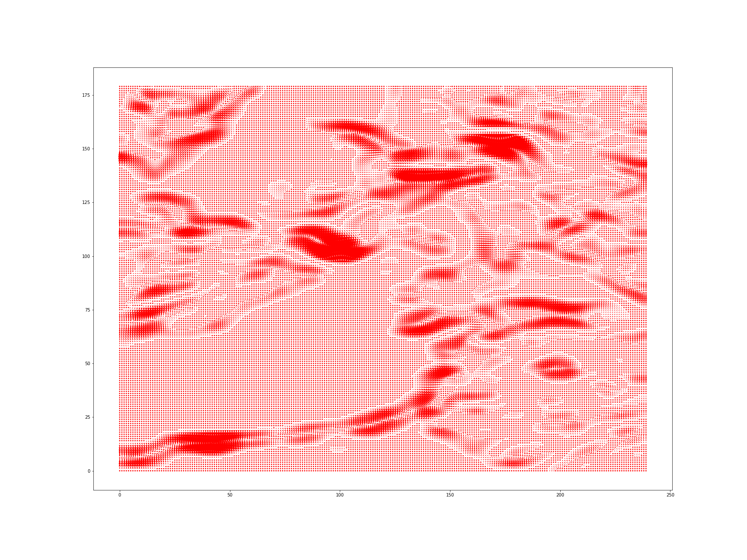
Directional Filters

Slide 12
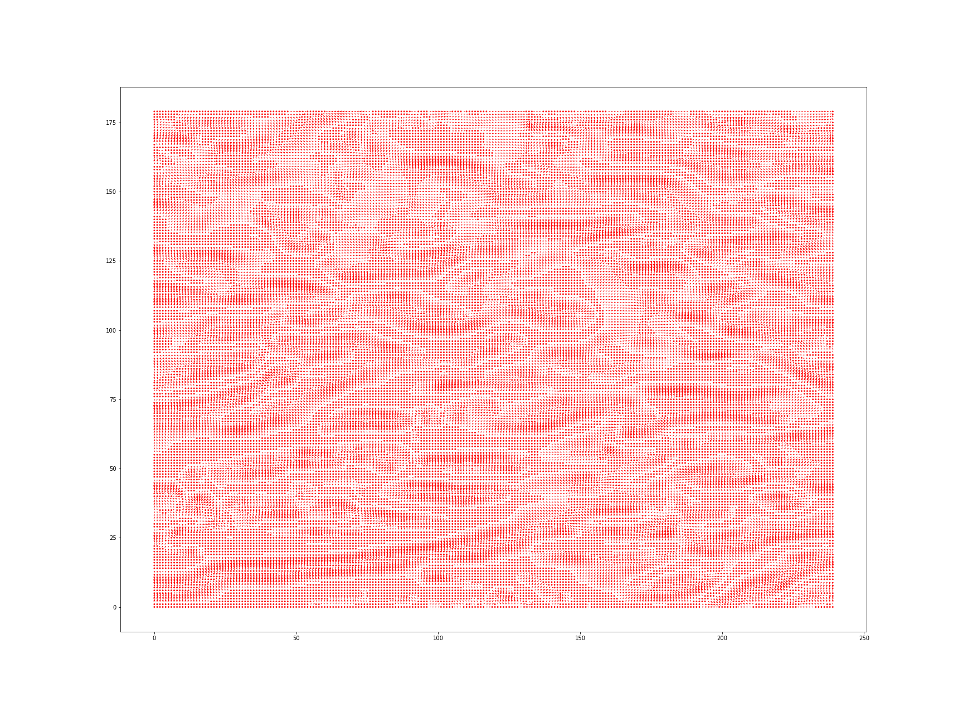
Normalized Neuron Response

Slide 13
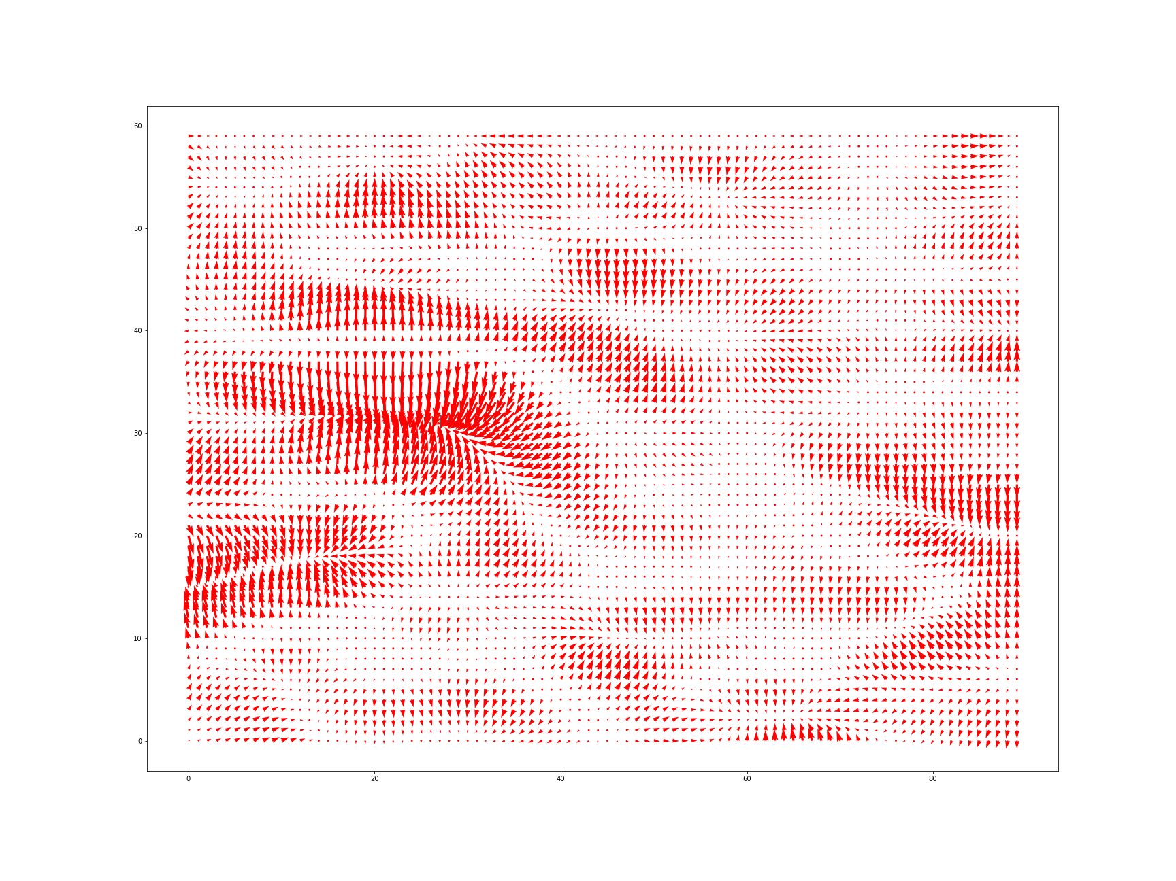
Subimage (x = 150, 240; y = 0, 60)

Slide 14
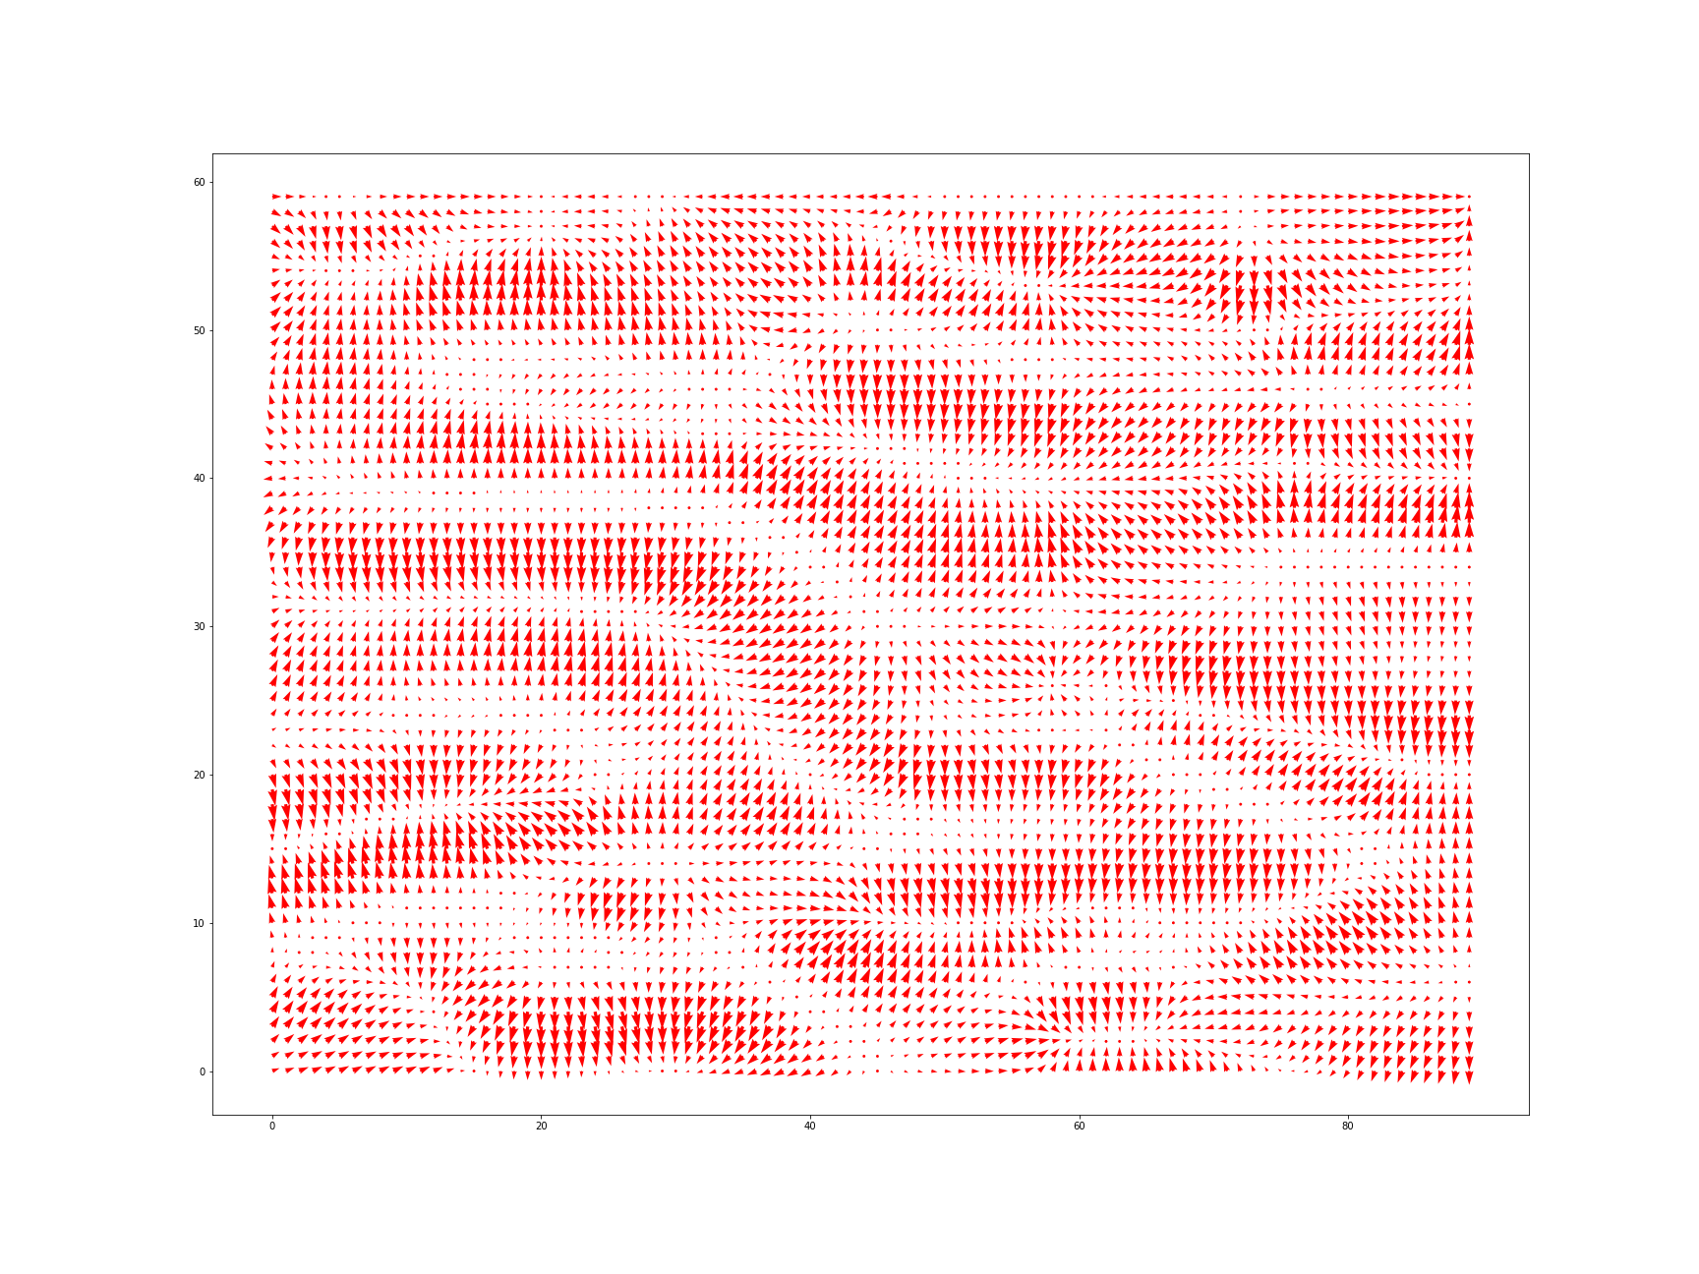
Normalized Subimage

Slide 15
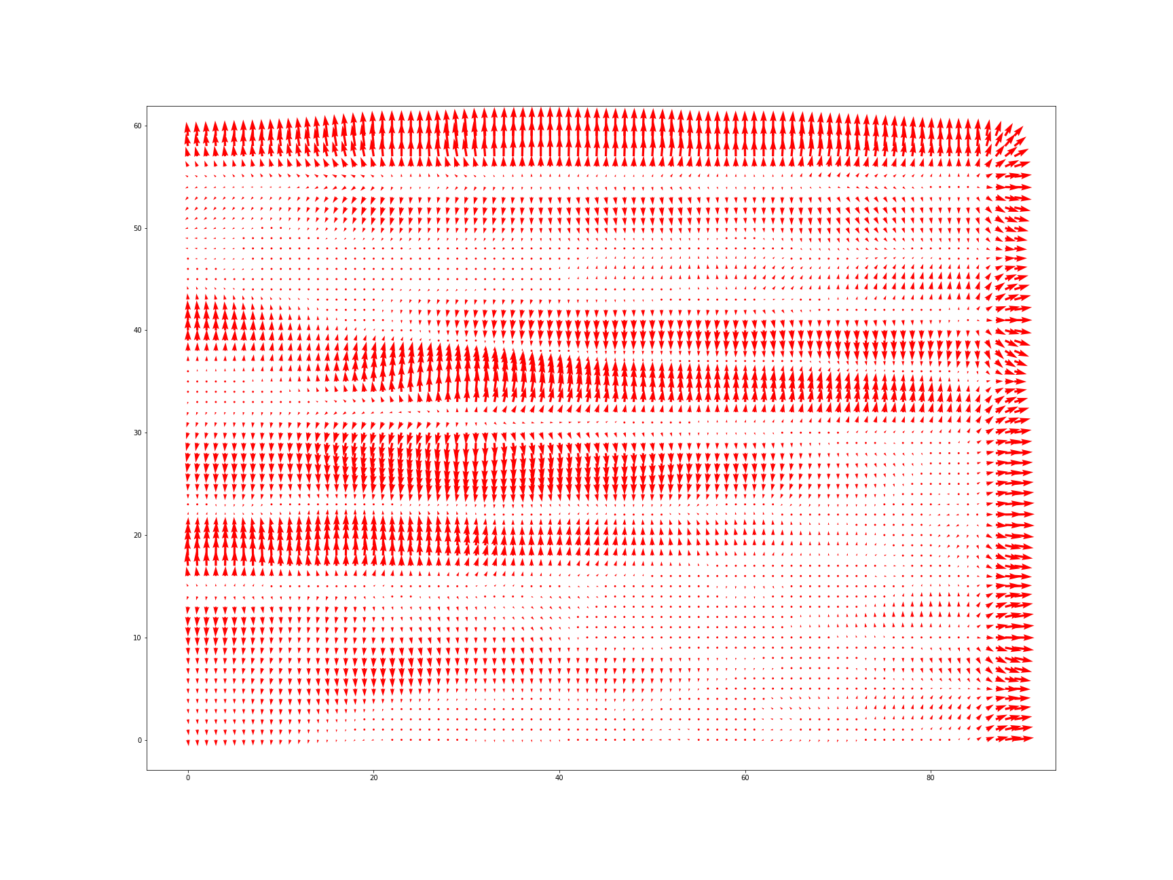
Subimage over time

Slide 16
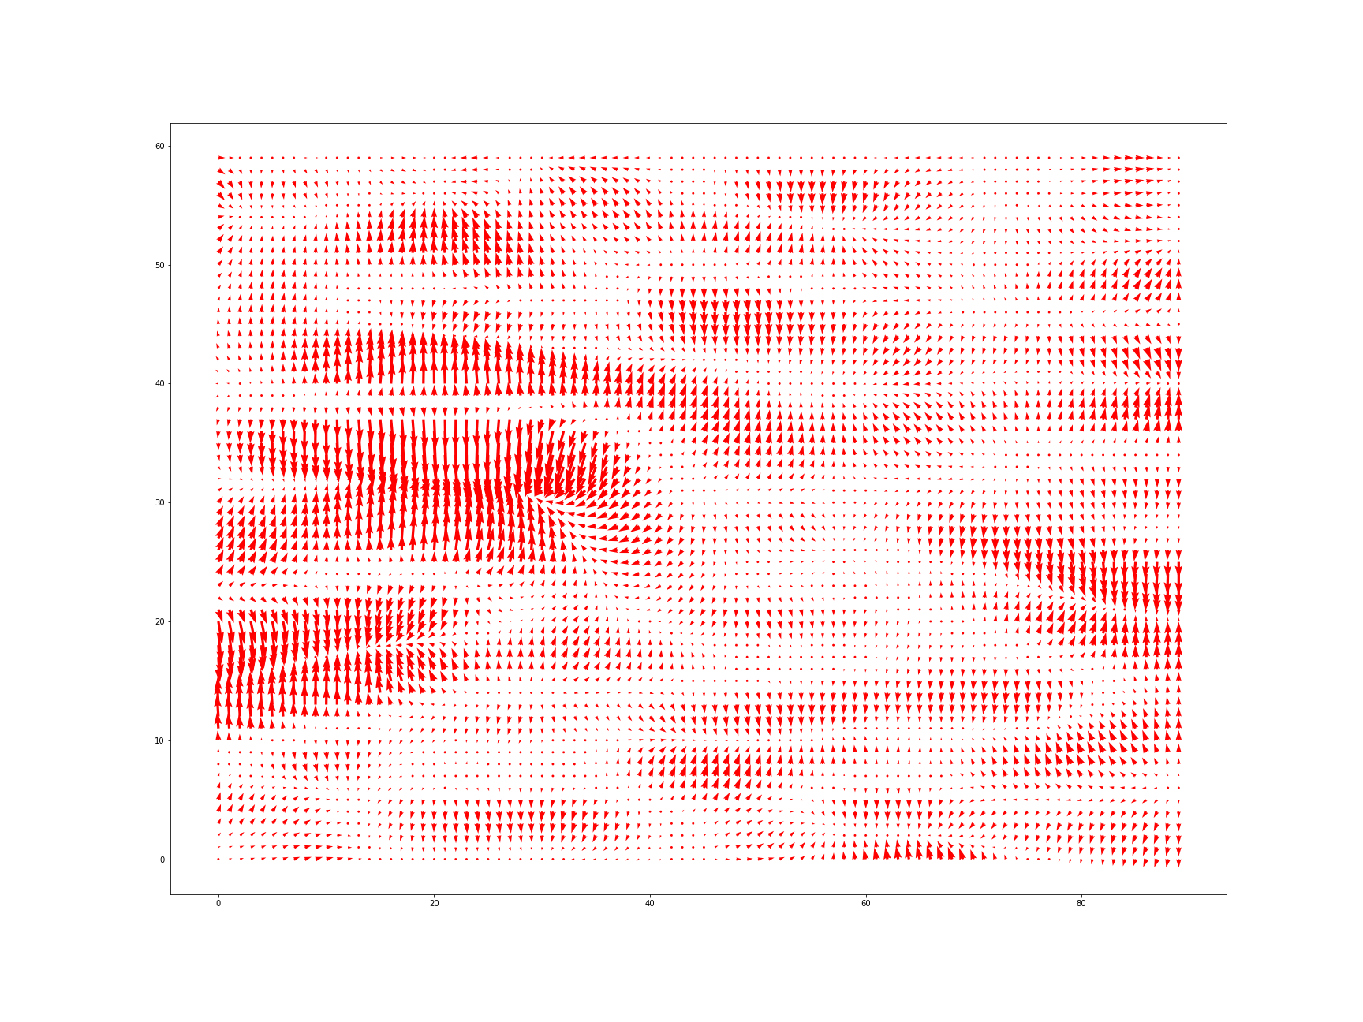
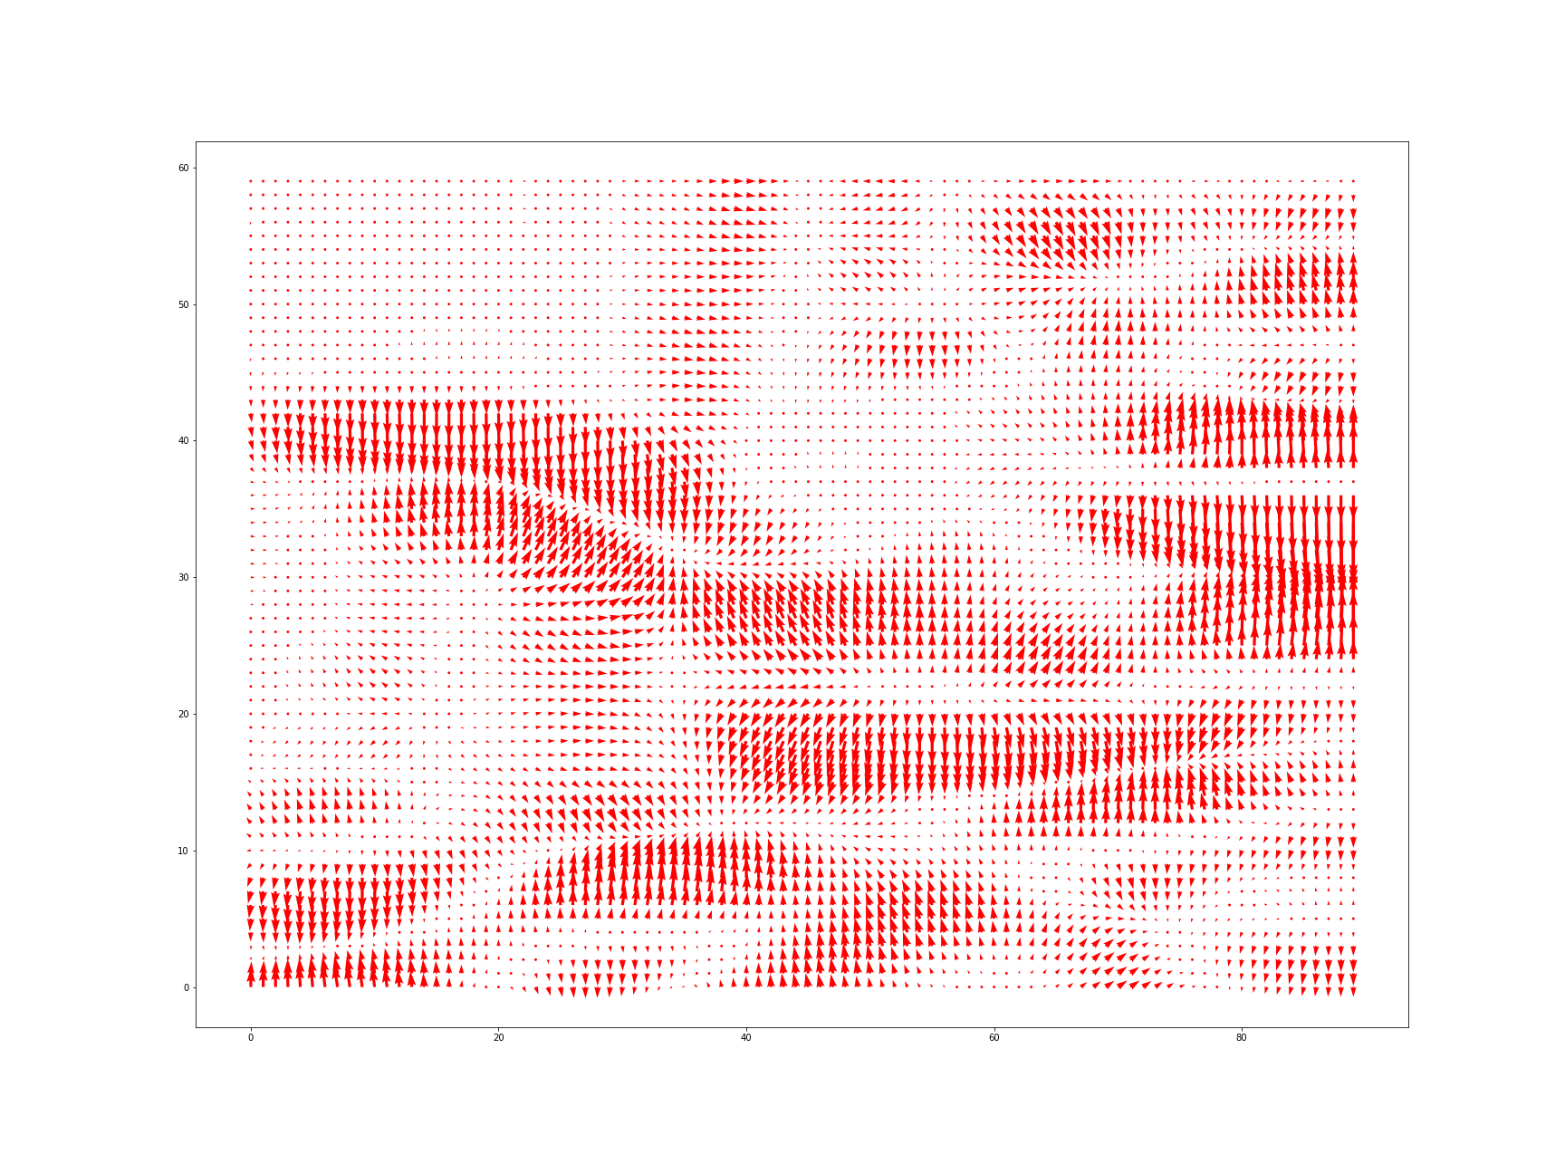
4 Filters vs 32 Filters

